Slide 1
Middle School
Standards Revisions for Math and ELA
2018-2019

Slide 2
Introduction to the North Carolina Standard Course of Study
Every 5 to 7 years NCDPI will review the standards for every content area to ensure the NCSCOS consists of clear, relevant standards and objectives.
NCDPI just completed this cycle for Math and ELA and in April 2017, the North Carolina State Board of Education adopted new ELA and Math standards for grades K-12.
The Standard Course of Study describes what students should know, understand,and be able to do by the end of each grade level.

Slide 3
Who was involved?
Feedback was given via surveys and focus groups from:
Parents
Community Members
Business/Industry Professionals
Higher Education Faculty
Educators (teachers, administrators, curriculum

Slide 4
Mathematics Assessment
2018-2019
New content standards taught
New forms built/assessed (New NC Math 3 EOC)
Test results will be delayed for EOG/EOC
2019-2020
Assessments (Edition 5) fully implemented

Slide 5
Reading Assessment
2018-2019
New standards taught
New standards field tested
2019-2020
New forms built/assessed
Test results will be delayed for EOG/EOC

Slide 6
Visit http://www.gaston.k12.nc.us and click on “Our Schools”

Slide 7
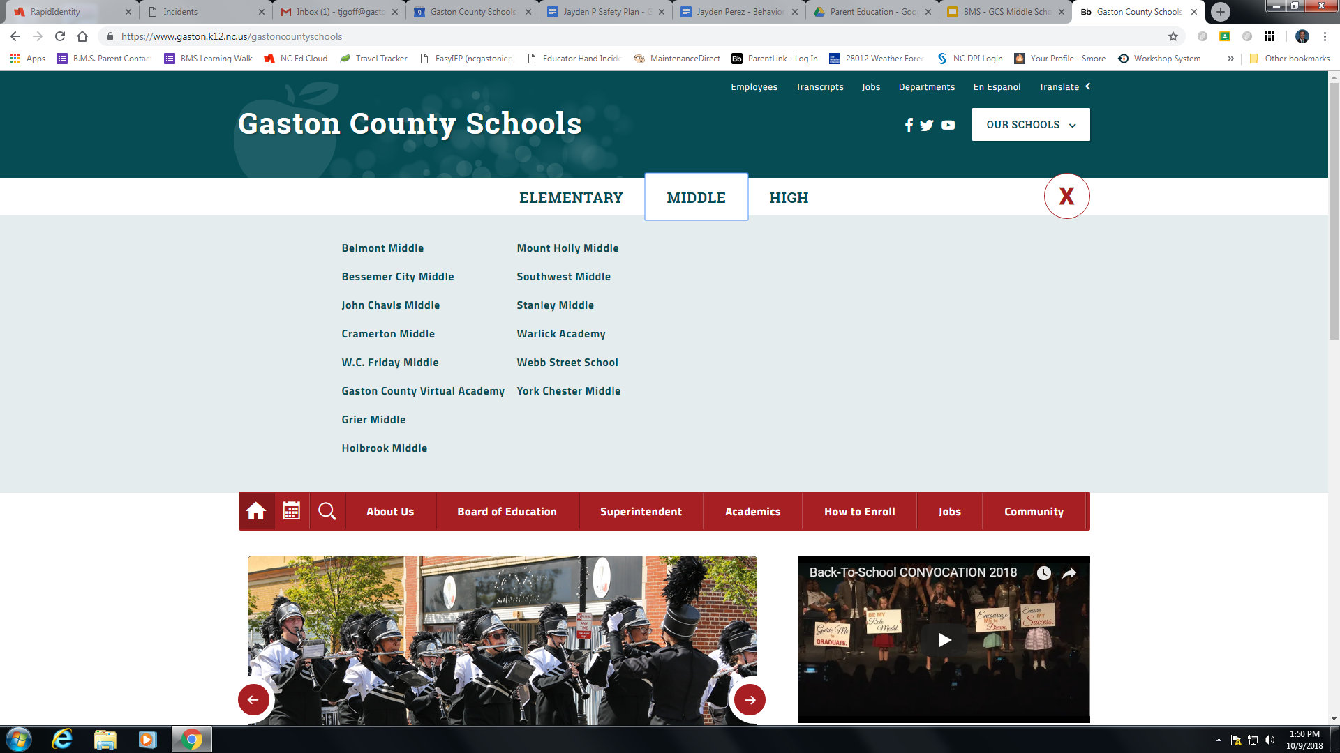
Click on “Belmont Middle School”

Slide 8
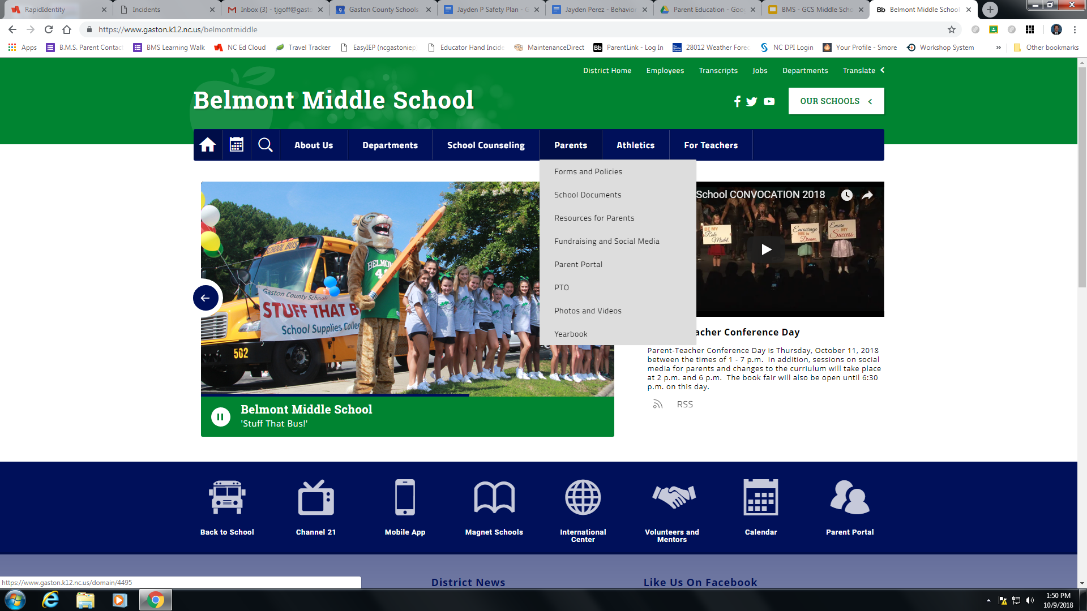
Click on “Parents” and then on “Resources for Parents”

Slide 9
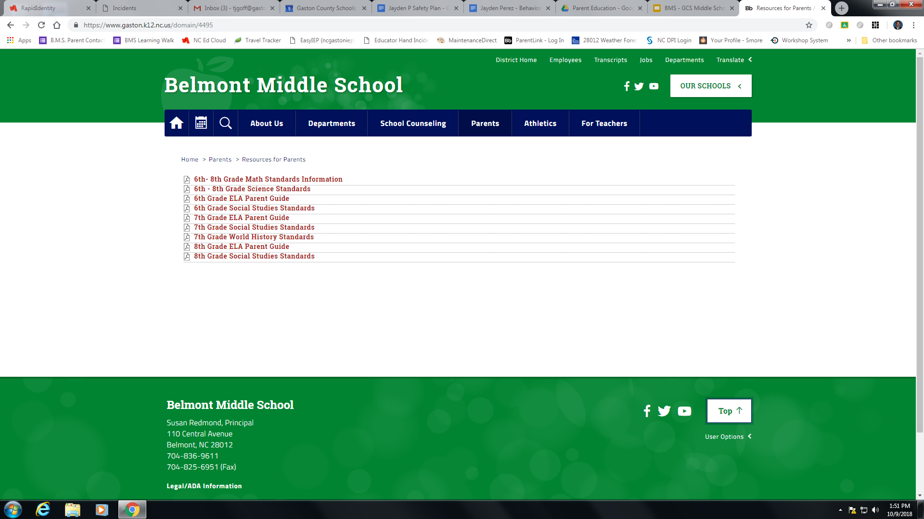
Scroll the page to view various information.

